Slide 1
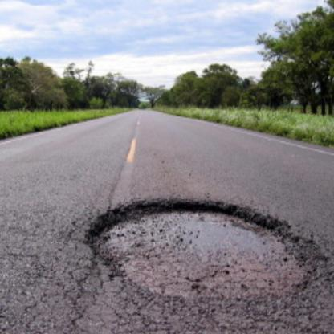
Project Title : Path hole detection using yolov4
Name: Salman Farshi
ID : 1520162042

Slide 2
Project workflow
Image collection , preprosseing and Annotatation
This data source is collected from Kaggle : Link : https://www.kaggle.com/anugrahakbar/potholes-detection-for-yolov4
The annotation contains a single label named "pothole" made for YOLO-V4 format.
IMAGE SHAPE: 416 x 416 TRAIN IMAGE: 1562 (79% ratio) TEST IMAGE: 421 (21% ratio)
2.Data training
3.Data testing &Result evalution

Slide 3
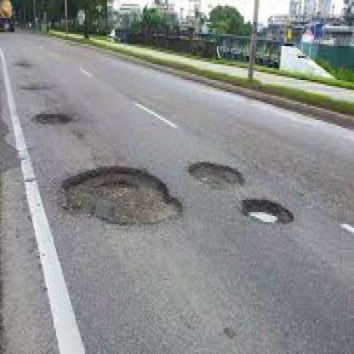
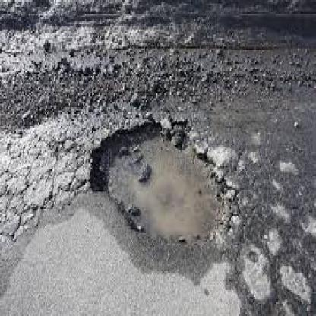
Training :
Framework : Darknet
Training tools : Google Colab
Number of class : 1 (pathole)
filters=18
batch=64
subdivisions=16
width=416
height=416
channels=3
MaX_Number of Iteration : 6000
Random: 0
# Others I have used default setting

Slide 4
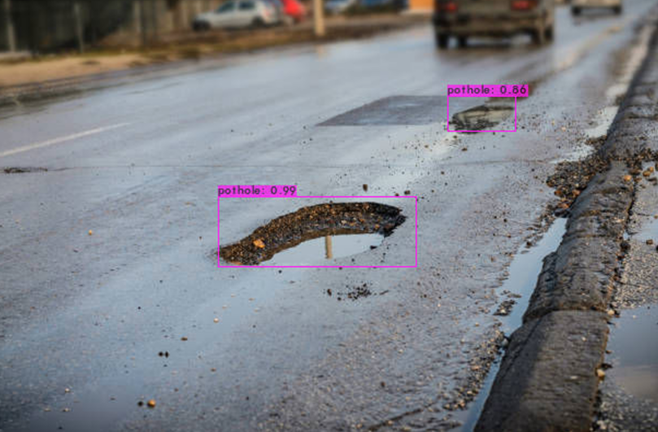
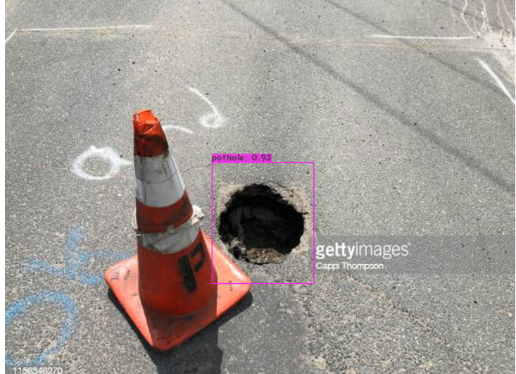
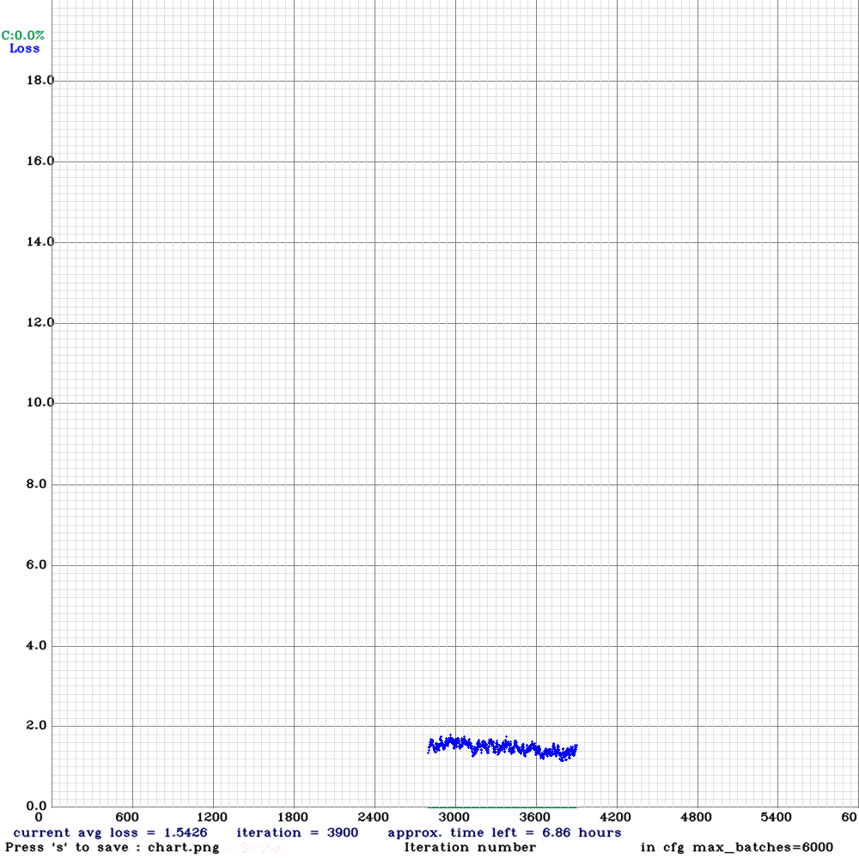
Results
Total iteration done : 3900
Best weight : 2000
mean average precision (mAP@0.50) = 0.742117, or 74.21 %
precision = 0.66, recall = 0.78, F1-score = 0.72

Slide 5
THANK YOU

